Slide 1
Web Mining – Twitter
Gustav Sternelöv

Slide 2
What is Twitter?
Social network, launched in 2006
Tweets, maximum 140 characters
1.3 billion registered users
320 million monthly active users
On average 303 million tweets/day (January 2016)

Slide 3
Access Twitter data
Two public API:s
Twitter REST API
Search against a sample of tweets published in the past 7 days
Streaming API
Tweets as they are tweeted, no sampling
R packages for easy access (twitteR, streamR)
Notes:
Twitter REST API:
Follower data, profile data, tweets
Limitation of requests
Searches against a sample of tweets
Streaming API
Tweets as they are tweeted
No sampling
Public stream and user stream
Recieve tweets depending on language, user/users, words/hashtags or location

Slide 4
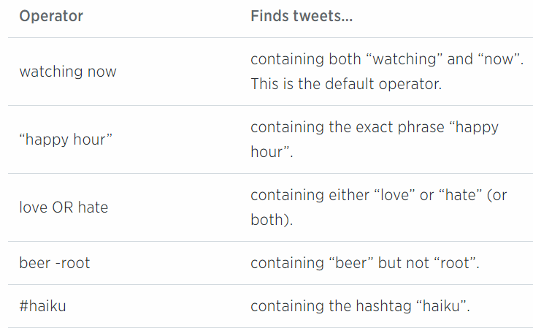
Access Twitter data
Twitter REST API
Querys from search API
Follower data, profile data, tweets
Limitation of requests
Twitter Search API
Searches against a sample of recent tweets
Tweets published in the past 7 days

Slide 5
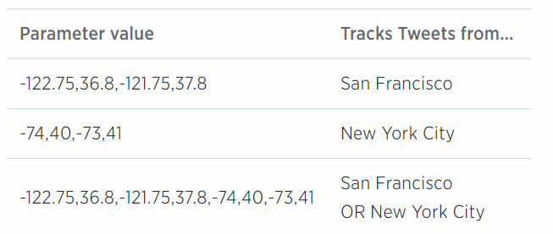
Access Twitter data
Streaming API
Location queries
Tweets as they are tweeted
No sampling
Public stream and user stream
Recieve tweets depending on language, user/users, words/hashtags or location

Slide 6
The use of tweets
Predict real world outcomes
Presidential elections
Box-office revenues for movies
Detect earthquakes
Learn about public reactions on an outbreak of a disease

Slide 7
The Ebola outbreak in tweets
Two aims
The use of Twitter as a real-time method of Ebola outbreak surveillance to monitor information spread
Examine content of public knowledge and attitude
Tweets in English about Ebola (July 24 – August 1, 2014)
42,236 tweets (16,499 unique, 25,737 RTs)

Slide 8
Mining of tweets – Step 1
Build a tweet corpus
Example of keywords:
#Ebola, #EbolaOutbreak, #EbolaVirus, #EbolaFacts.
Information received from tweets:
Content, time stamp, geographic location, user name, message type (unique or RT) and number of followers.

Slide 9
Mining of tweets – Step 2
Text cleaning
Remove non-standard or special characters (”, ´, ’, ;, ^, @)
Spaces, www, http and similar parts of the tweets also removed
Text Transformation
Content is represented as a vector of features
Individual words has the frequencies of occurences as feature
Other features: N-grams and numeric features

Slide 10
Mining of tweets – Step 2, cont.
N-grams
A subsequence of N items
An example: ”What is Ebola?”
3 unigrams: ” What”, ” is”, ”Ebola”
2 bigrams: ” What is”, ” is Ebola”
1 trigram: ” What is Ebola”
Each generated unigram, bigram, trigram and so on is an attribute

Slide 11
Mining of tweets – Step 3
Dimensionallity reduction
Two methods: Removal of stop words and stemming
Stop words
Common words with little information (”the”, ”to”)
Stemming
Identify a word root and remove suffices and prefixes from different word forms
Porter’s Algorithm

Slide 12
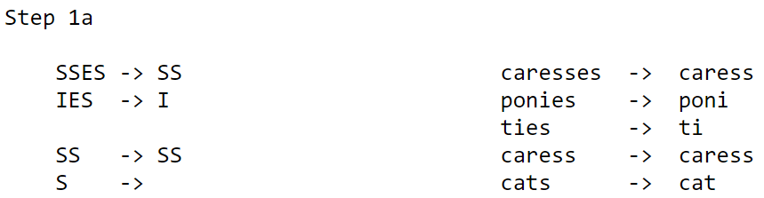
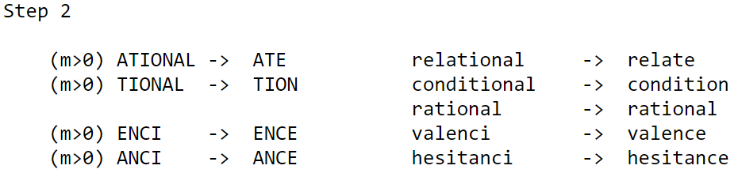
Mining of tweets – Step 3, cont.
Porter’s algorithm
One of the most common approaches for stemming

Slide 13
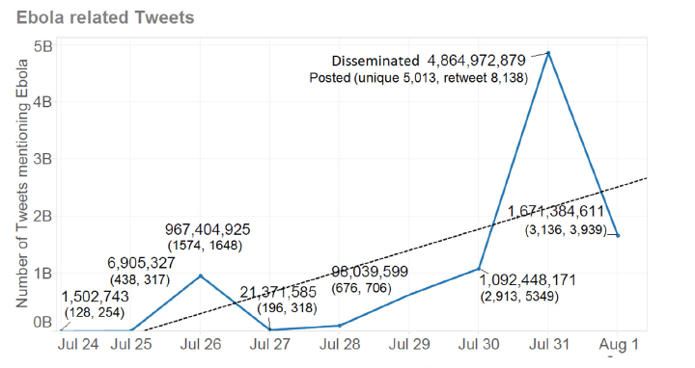
Mining of tweets – Step 4
Analyze data – The Ebola outbreak
Time-series to analyze increase in number of tweets and geographical spread

Slide 14
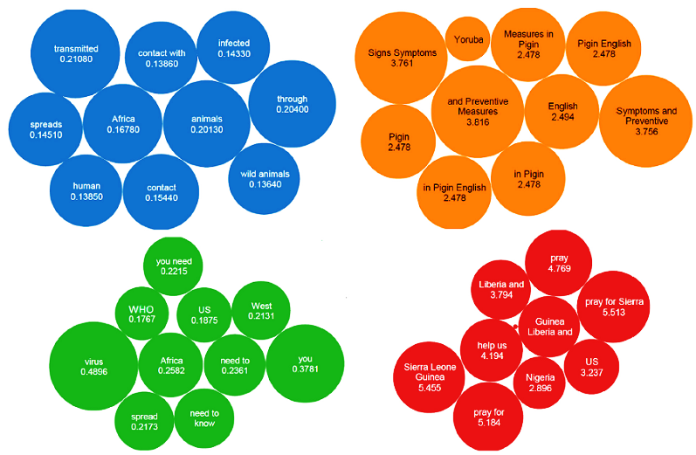
Mining of tweets – Step 4, cont.
N-grams clustered with the k-means algorithm

Slide 15
The US presidential election in 2012 reflected in tweets
Aim:
Compare sentiments about candidates and keywords before and after the election
Tweets from October to November 2012
Total of 196,000 tweets
Example of keywords:
Candidate names, election related hashtags and candidates hashtags

Slide 16
The US presidential election in 2012 reflected in tweets, cont.
Text cleaning:
Removal of stop words, punctuation symbols etc.
Deleted all RTs
Converted emoticons to words
Sentiment analysis
Aim is to classify tweets as positive or negative
3 scoring functions (Score.polarity, Score.sentiment and Score.afinn)

Slide 17
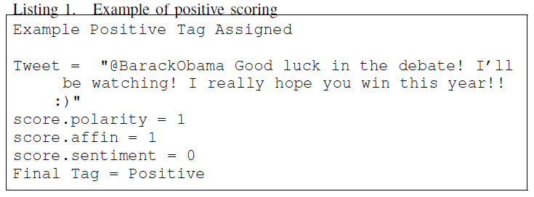
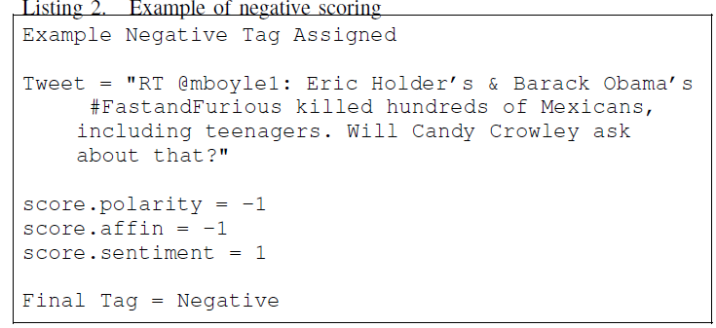
The US presidential election in 2012 reflected in tweets, cont.

Slide 18
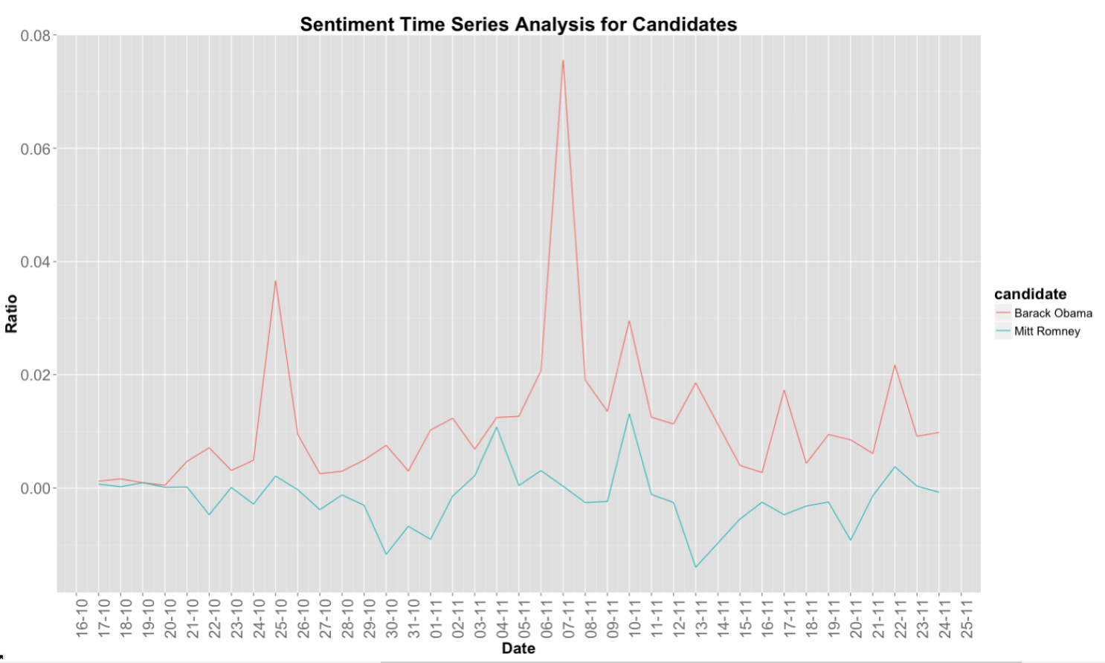
The US presidential election in 2012 reflected in tweets, cont.

Slide 19
Sources

